Slide 1
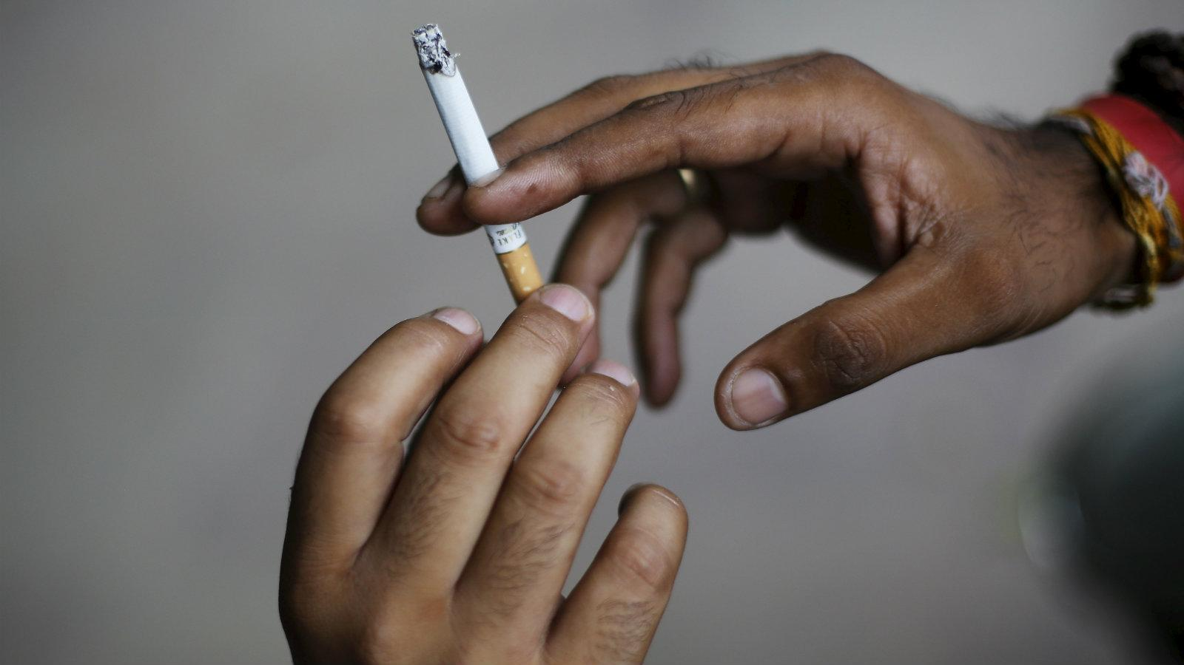
NICOTINE ADDICTION
PDG DR deepak purohit

Slide 2

With inputs from
Dr Rohan Bartakke
Crusader
Anti tobacco movement

Slide 3
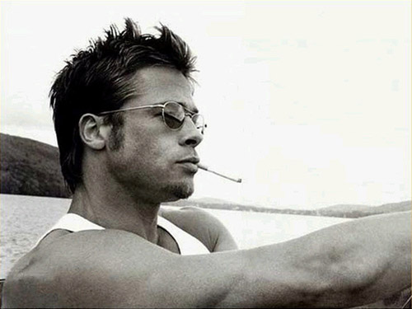
Style statement??

Slide 4

Cooooool!

Slide 5
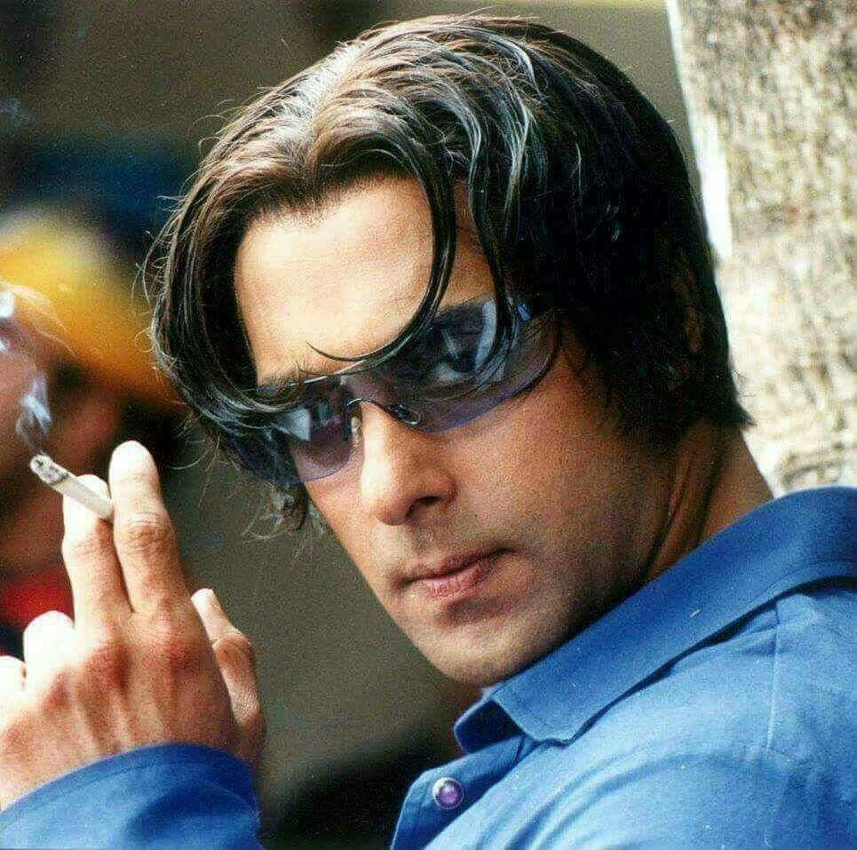
Following IDOL

Slide 6


I am a Man

Slide 7
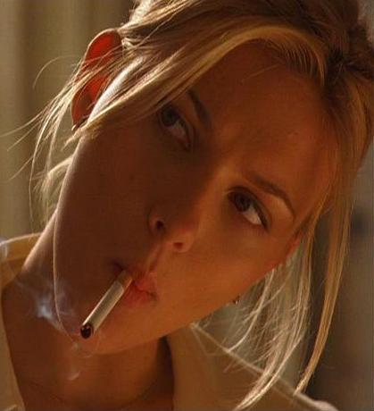
I am
Liberal

Slide 8
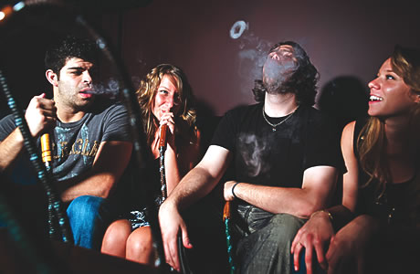
Bonds of friendship

Slide 9
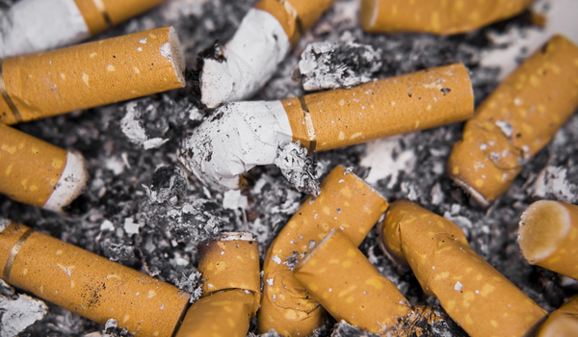
Reality Check …

Slide 10

Smoking Kills

Slide 11

Kiss of cigarette

Slide 12
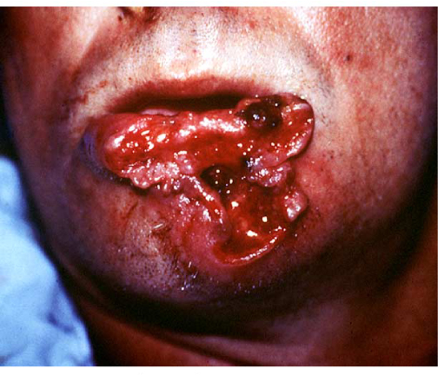
A kiss of Death

Slide 13
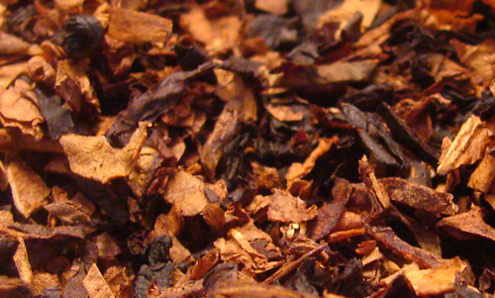
Really, tobacco harms people

Slide 14
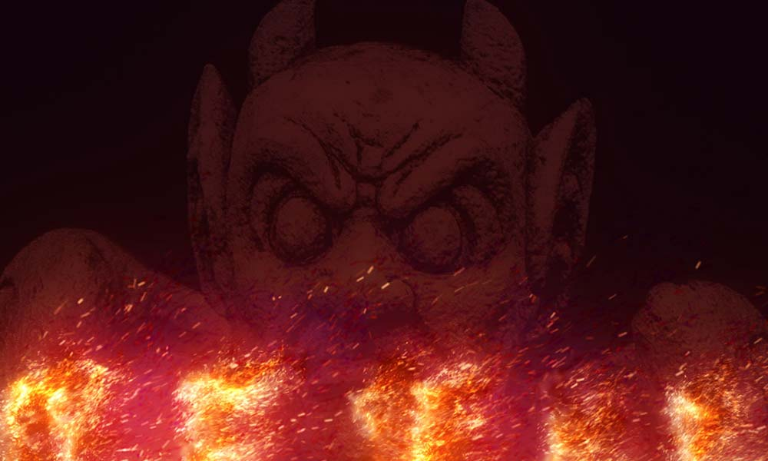
Tobacco devil
Cigarette, Cigar, Bidi, Gutka, Panmasala (with tobacco), Khaini, Mava, Sniff, tobacco toothpastes

Slide 15
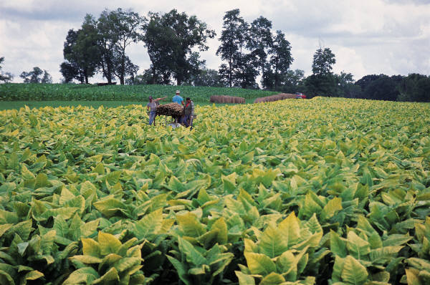

Healthy person
Tobacco
Notes:
What is a meaning of healthy person?

Slide 16
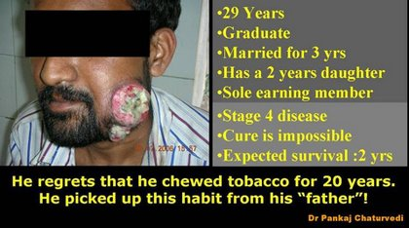

Slide 17
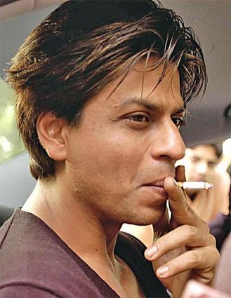
Real Hero
stays away from tobacco
Notes:
How many people like Shaharukh Khan? Why? He is hero and having cigarette in his mouth/ lips.

Slide 18
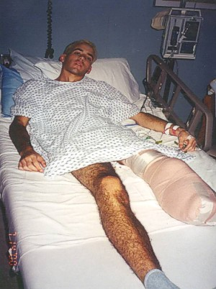
Family life affected
Harmful effects
on body
Financial
loss
Psychological illness
Hero is now a zero

Slide 19


In India
Lives lost
due to
Tobacco
2500 daily
10 lac annually
Notes:
Do you know how many lives we lost daily and annually in India?

Slide 20
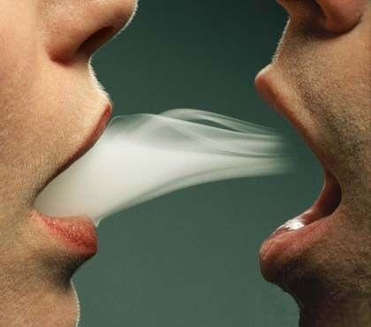
PASSIVE (secondhand) smoking
Notes:
Second hand smoking is it’s indirect weapon.

Slide 21
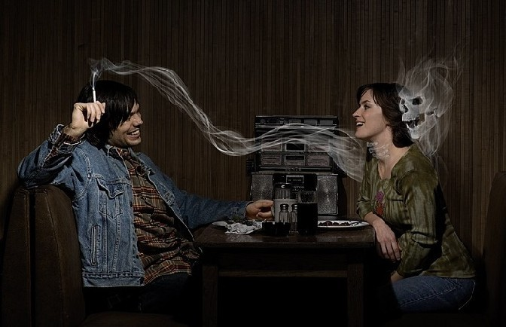
Passive smoking
Inhaling air containing tobacco smoke is called Second-hand smoking
Effects of this smoke are similar to smoke inhaled by an active smokers.

Slide 22
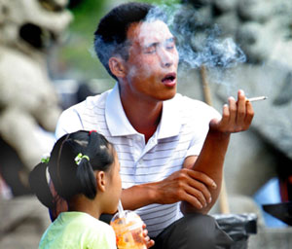
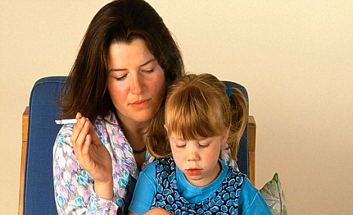
Second-hand smoking
The risks of Second-hand smoking do not stop with cancer. There is an increased incidence of heart disease in passive smokers.
Children of parents who smoke have an increased incidence of cough, bronchitis, ear infection and pneumonia.

Slide 23



Smokers kill
Themselves &
Family
Child
Friends

Slide 24
Third-hand smoking
Invisible, yet toxic brew of gases and particles clinging to a passive smoker’s hair and clothes pass on to others who come in contact with the smoker

Slide 25

Cushions and carpets carry cigarette smoke even after a smoker has left the room
A wall with cigarette smoke particles when contacted by a child who then puts finger in mouth gets affected
Food items lying in the room get contaminated

Slide 26
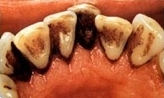
Short-term effects
Ear infection
Sore throat
Yellow & decayed teeth
Bad breath
Smelly hair
Smell disorder
Constipation
Depression

Slide 27

Reduces the ability to think and concentrate
Itching eyes
Watery eyes
Dark circles under eyes

Slide 28

India is number one in oral cancer cases
Need to stub out
this statistics!

Slide 29
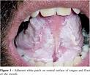

Symptoms of oral cancer…
Leukoplakia
A white patch in the mouth
Develops at the site where the person places the tobacco in the mouth

Slide 30

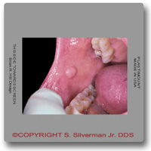
Symptoms of oral cancer…
Erythroplakia
A red patch in mouth
A velvety red patch that develops in the mucosa

Slide 31
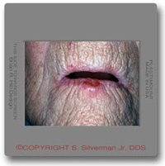
Symptoms of oral cancer…
Sub-mucous Fibrosis
A chronic mucosal condition
resulting in uniform
whitish discoloration of
the entire oral cavity
with difficulty in opening mouth fully & intolerance to spicy food

Slide 32
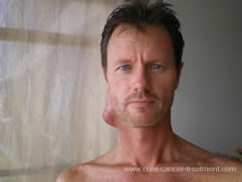
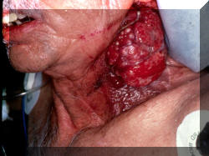
Symptoms of oral cancer…
Non healing Ulcers
Usually painless,
keeps increasing in size
& do not show signs of healing
Ulcer in the mouth needs
to be operated
Operation involves cutting away a portion of the mouth making the patient’s face look horrible

Slide 33
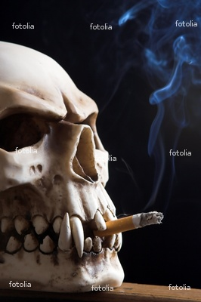
Tobacco & Cancers
Nose
Lung
Throat (Pharynx & Larynx)
Food Pipe
Stomach
Urinary Bladder
Kidney
Cervix
Penis
Laryngeal
Gallbladder

Slide 34
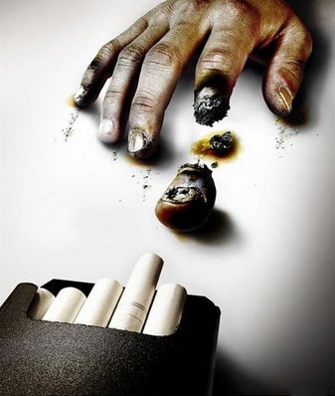
Long-term effects
Chronic Bronchitis
Reduced lung function
Asthma
Coronary Heart disease
Heart Attack
Emphysema

Slide 35
Long-term effects
Gum Disease
Tuberculosis
Diabetes
Cataract
Gangrene
Weakness

Slide 36
Long-term effects
Paralyses
Affects nerves
Stroke
Macular degeneration (Blurred Vision)

Slide 37
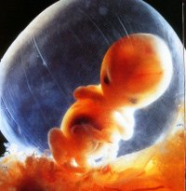
Don’t kill me, I want to live…
Cigarette smoke kills your child

Slide 38
Impotency
Infertility
Miscarriage
Still Birth
Low birth weight babies
Sudden Infant Death Syndrome (SIDS)

Slide 39

Tobacco and Environment
To make edible, tobacco is baked resulting in deforestation
Production of tobacco results in land & water pollution
Every 300 cigarettes require cutting down of one tree
(About a two-week supply for a pack-a-day smoker)
Tobacco smoke pollutes the environment
Spitting tobacco dirties the surroundings

Slide 40
Tobacco and Environment
Tobacco packages make waste in the environment
In the year 1933, In U.S., all cigarette butts thrown away weighed as much as 30,800 large elephants.

Slide 41
Tobacco and Environment
Through storm drains
cigarette butts reaches
rivers, lakes and the ocean
from city streets
Seabirds, sea animals and fishes eating these are unable to digest the filters and die
Cigarette butts takes
an average of 25 years
to decompose

Slide 42
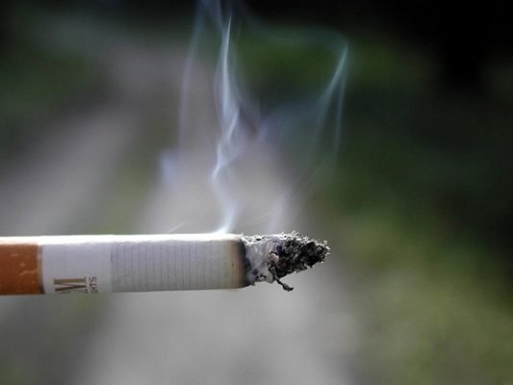
There are more than 4000 harmful chemicals in tobacco and its smoke!

Slide 43
Nicotine: A powerful central nervous system stimulant found naturally in the tobacco leaf is classified as a drug. In higher doses, nicotine is extremely poisonous. It is commonly used as an insecticide.
Benzo[a]pyrene: You’ll find it in coal tar and cigarette smoke. It is a chemical likely to cause cancer in humans.
Arsenic: This deadly poison causes diarrhea, cramps, anemia, paralysis and malignant skin tumors. It's used in pesticides.
Acetone: It's one of the active ingredients in nail polish remover.
Lead: Lead poisoning stunts your growth, makes you vomit and damages your brain

Slide 44
Formaldehyde: Causes cancer, can damage your lungs, skin & digestive system. Embalmers use it to preserve dead bodies
Phenol: Phenol is a chemical used in chemistry tests - the kind you might see done in a laboratory
Cadmium: It causes damage to the liver, kidneys and brain & stays in the body for years
Benzene: It is found in pesticides and gasoline
Ammonia: Scientists have discovered that ammonia lets you absorb more nicotine - keeping you hooked on smoking.

Slide 45
Others Friends of tobacco:
Paan
Chuna is lime or calcium carbonate.
It is an alkaline substance and can eat away into substances as hard as the marble on which it is placed in the paanwala shop.
If chuna can dissolve marble, you can imagine what it will do to the lining of your cheek.

Slide 46
Kimam / Tobacco Chewing
This is a brown colored paste, which is applied on the pan leaf.
It is very poisonous.
If you put a safety pin or a plain pin in a bottle of kimam and leave it overnight, it would start dissolving.
You probably know that pins and safety pins are made of iron. If kimam can dissolve iron, you can imagine what it will do to the lining of your cheeks.

Slide 47
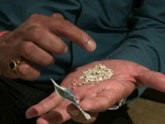
Gutkha
Gutkha contains many harmful substances, one of which is Magnesium Carbonate.
So Maharashtra Govt. banned this harmful product. Whoever eats Gutkha has 400% risk of developing cancer.

Slide 48
Gutkha
A daily intake of an average of ten pouches of Gutkha per day would mean exceeding the recommended daily intake of lead, arsenic and copper.
Lead is particularly dangerous for the younger age group, as excess of it lowers the IQ level. So it could also affect the scholastic performance of children.

Slide 49

Tobacco companies have now produced a range of brands aimed at women.
Most notable are the “women-only” brands: these “feminised” are long, extra-slim, low-tar, light coloured or menthol.

Slide 50
But we have to remember

Slide 51
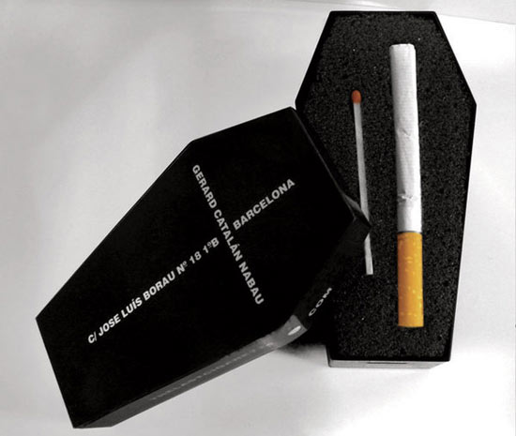
Tobacco is the
number one killer
in the world.
Tobacco causes 1 in 10 deaths (10%) worldwide, nearly 5.4 million a year.

Slide 52
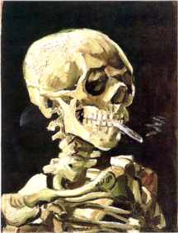
100 million
deaths were caused by tobacco in the twentieth century.

Slide 53
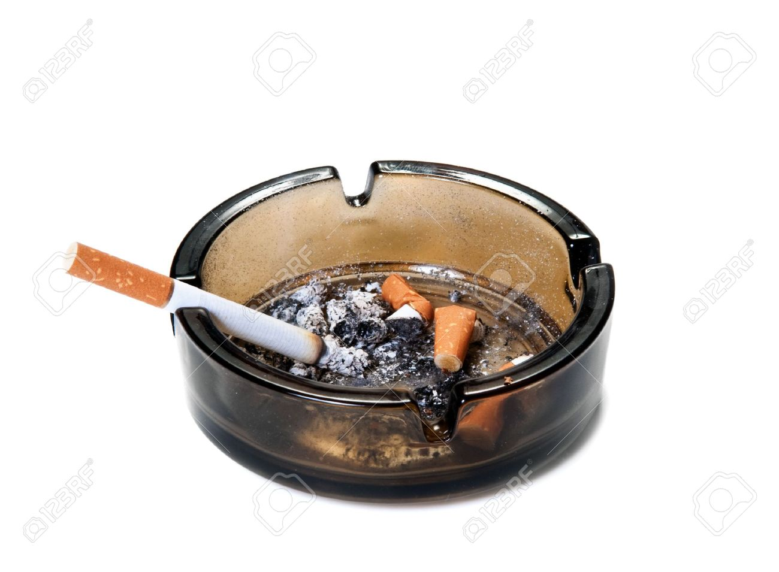
If the current trends continue, there will be
1 billion
deaths in the twenty-first century.

Slide 54
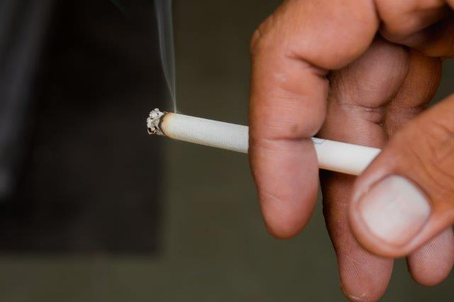

Slide 55
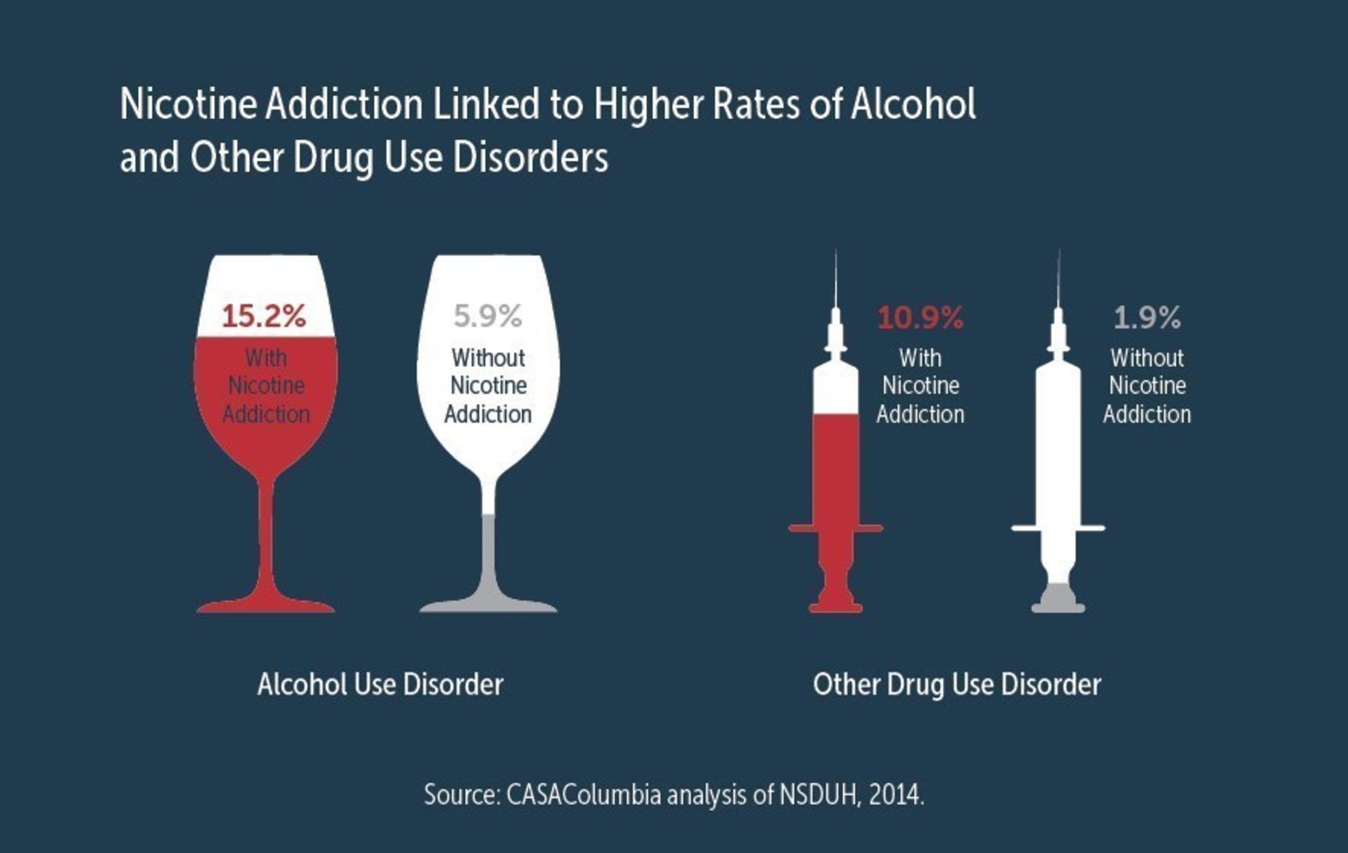

Slide 56
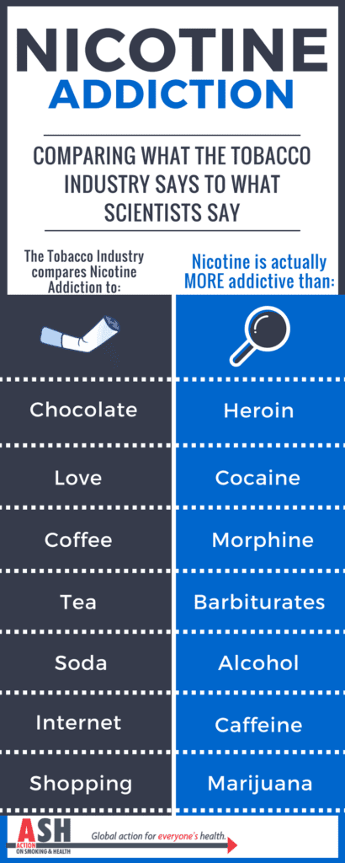

Slide 57
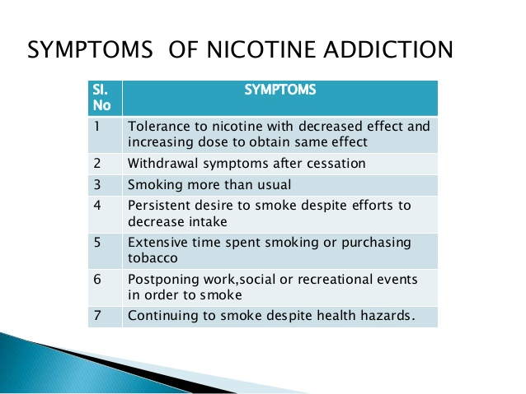

Slide 58
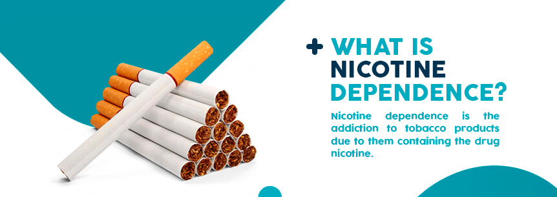

Slide 59
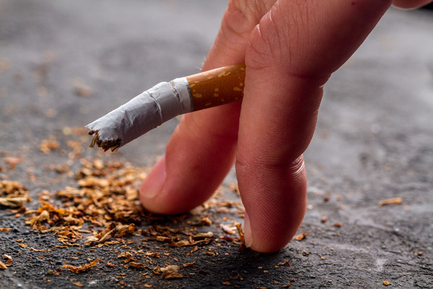

Slide 60
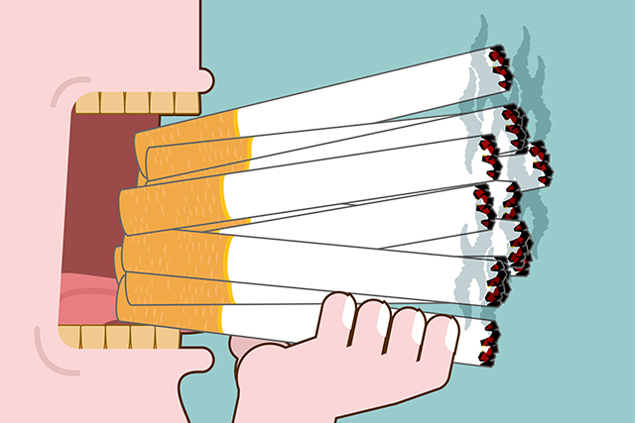

Slide 61
Now is the time to think
About yourself
and
the fatal threat of Tobacco …

Slide 62
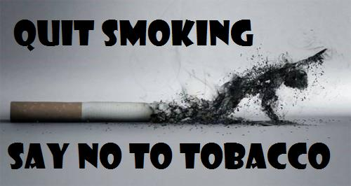

Slide 63
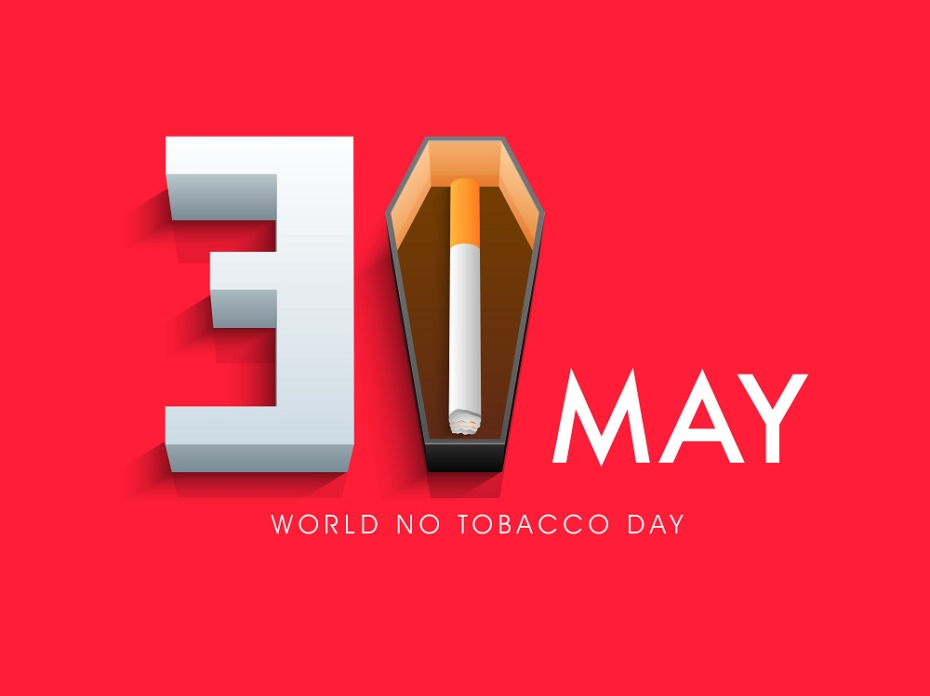
World NO TOBACCO day

Slide 64
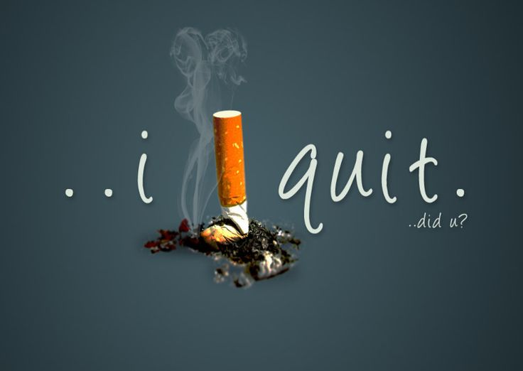

Slide 65
How do we
Fight against Tobacco
?

Slide 66
Lot of smokers start smoking at their teen age.
Research shows, if the person doesn’t smoke till the age of 18; the chances are low to consume tobacco in his/her adulthood.
Schools to be known as tobacco shops
Children seem to smoke on roads.
Lay person is not aware about the ill effects of tobacco.

Slide 67

COTPA, 2003
Cigarettes and Other Tobacco Products
(Prohibition of Advertisement and Regulation of Trade and Commerce, Production, Supply and Distribution) Act, 2003

Slide 68
Objectives of the Act
Effective protection is provided to non smokers from involuntary exposure to tobacco smoke.
Protect children and youth from being addicted to tobacco.
The Act extends to whole of India.

Slide 69
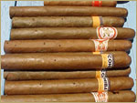

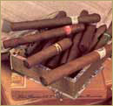
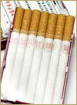

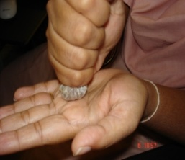
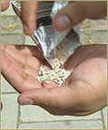
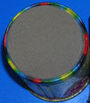
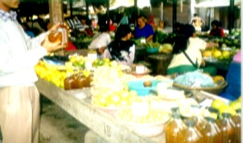
Act says …
The Act is applicable to all products containing tobacco in any form i.e.
Cigarettes
Cigars
Cheroots
Beedis
Cigarette
Pipe tobacco
Hookah
Chewing tobacco
Snuff, Gutka
Pan masala (containing tobacco)
Tooth powder containing tobacco

Slide 70
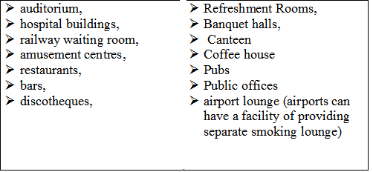
Public Places [as per sec.3(l) of COTPA r/w
Rule 2(d)] of Prohibition of Smoking in Public Places Rules, 2008 includes

Slide 71
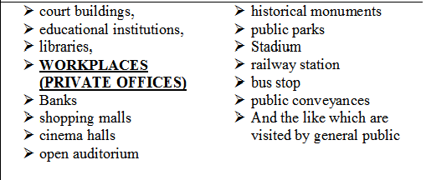

Slide 72

Public place must have the following Sign Board (Schedule II)

Slide 73
Napoleon........
"The world suffers a lot. Not because of
the violence of bad people, but because of the silence of good people."

Slide 74

So
Get courage to stop people whenever you see them smoking in public places.

Slide 75


Amendments done in 2005
Indirect Advertisement
The use of a name or brand of tobacco products for marketing, promoting or advertising other goods, services and events.
The marketing of tobacco products with the aid of a brand name or trademark which is known as, or in use as, a name or brand for other goods and service.
The use of particular colours and layout and/or presentation those are associated with particular tobacco products.
The use of tobacco products and smoking situations when advertising other goods and services.
Notes:
75

Slide 76







Indirect ads of Tobacco Product

Slide 77




SPECIFIED HEALTH WARNINGS TO BE DISPLAYED ON TOBACCO PRODUCT PACKS as notified on 5th July 2006
For smoking forms of tobacco packs
For chewing/smokeless forms of tobacco packs

Slide 78



Amendments done in 2009
Every tobacco product should have specified health warnings, without it nobody can sell it.
The specified health warnings shall occupy at least forty percent of the principal display area/s of the pack
It shall be positioned parallel to the top edge of the package

Slide 79
Amendments done in 2009
No messages that directly or indirectly promote a specific tobacco brand or tobacco usage in general are inscribed on the tobacco product package.
The warnings shall be inscribed in English and regional language or the other language used on the pack, but not more than two languages.
No tobacco product package or label shall contain any information that is false, misleading, or deceptive

Slide 80
Amendments done in 2011
Health spots or messages of minimum 30 seconds duration each at the beginning and middle of the old & new films (Indian and foreign) and TV Programs who having scenes of using tobacco products.
Anti tobacco health warning as a prominent scroll at the bottom of the screen during the period of such display.
Anti tobacco health warning scroll shall be legible and readable with font in black colour on white background.
Warnings: “Smoking Causes Cancer or Smoking Kills” for smoking forms of tobacco use.
Notes:
80

Slide 81
Amendments done in 2011
Warnings: “Tobacco Causes Cancer or Tobacco Kills” for chewing and other smokeless forms of tobacco use.
Language of the warning should be same as the language of film and TV programs .
Old and New TV programs who has scenes of tobacco use should be telecast at such timings that are likely to have least viewership from persons below the age of 18 years.
The owner or manager of cinema hall and broadcasters will take care of the rule.
New films having scene of tobacco use will get U/A certification
Notes:
81

Slide 82
Amendments done in 2011
Actors to give information about ill effects of tobacco products in the beginning and middle of film or TV program. The disclaimer should be minimum 20 seconds.
In new films, the scene showing close ups of tobacco products and packages should be edited in old films and TV programs such scenes should be blurred in new films and TV programs
Promotional materials and posters of films and TV programs should not depict any tobacco products or their usage in any form.
Notes:
82

Slide 83






Amendments done in 2011
Health warnings on
Smoking products
Health warnings on
Non Smoking products

Slide 84
Only Legislations
are
not enough

Slide 85

Offer help to quit tobacco use
Tobacco Cessation
Tobacco quitting/ cessation is not an easy task. It requires tremendous willpower
to quit.
people need to create
positive attitude
and enhance their willpower.

Slide 86
Offer help to quit tobacco use
The following methods can be used for tobacco
cessation.
Declaration: Declare your date of quitting and tell your family members / friends.
Avoid: Avoid people and places where you are tempted to consume tobacco.
Take up hobbies that keep your hands busy
Recall the happy moments in your life.
Exercise: Jogging, Breathing, skipping etc.

Slide 87


Methods to avoid Tobacco
Drink Water: It will flush out the chemicals.
Instead of tobacco products eat food items like peanuts
Discuss: Talk about your thoughts and feelings.

Slide 88


Methods to avoid Tobacco
Ride out: Ride out the desire; It will go away but do not fool yourself thinking you can just have one.
Reward: Reward yourself in ways that don’t cost money
Medication: If you are not able to control your self by using the above methods then go ahead and take medical help for cessation.

Slide 89

Let Us SaveYoung India
From Tobacco

Slide 90



Tobacco Free Colleges

Slide 91
We can do...
Criteria of Tobacco Free Education Institutes
Display of “Tobacco free School” or “Tobacco-free Institution” board
2. No sale of tobacco products inside the premises and Within the radius of 100 yards from school /
3. No smoking or chewing of tobacco inside the premises of institution by students/ teachers/ other staff members / visitors.

Slide 92
4. Display of sign boards “No Smoking Area- Smoking here is an offence”,
5. Posters with information about the harm effects of tobacco
6. A “Tobacco Control Committee” shall be in place

Slide 93


Slide 94


Slide 95
Let’s make your College and University Tobacco Free.

Slide 96


Slide 97


