Slide 1
De-Addiction from Screen

Slide 4
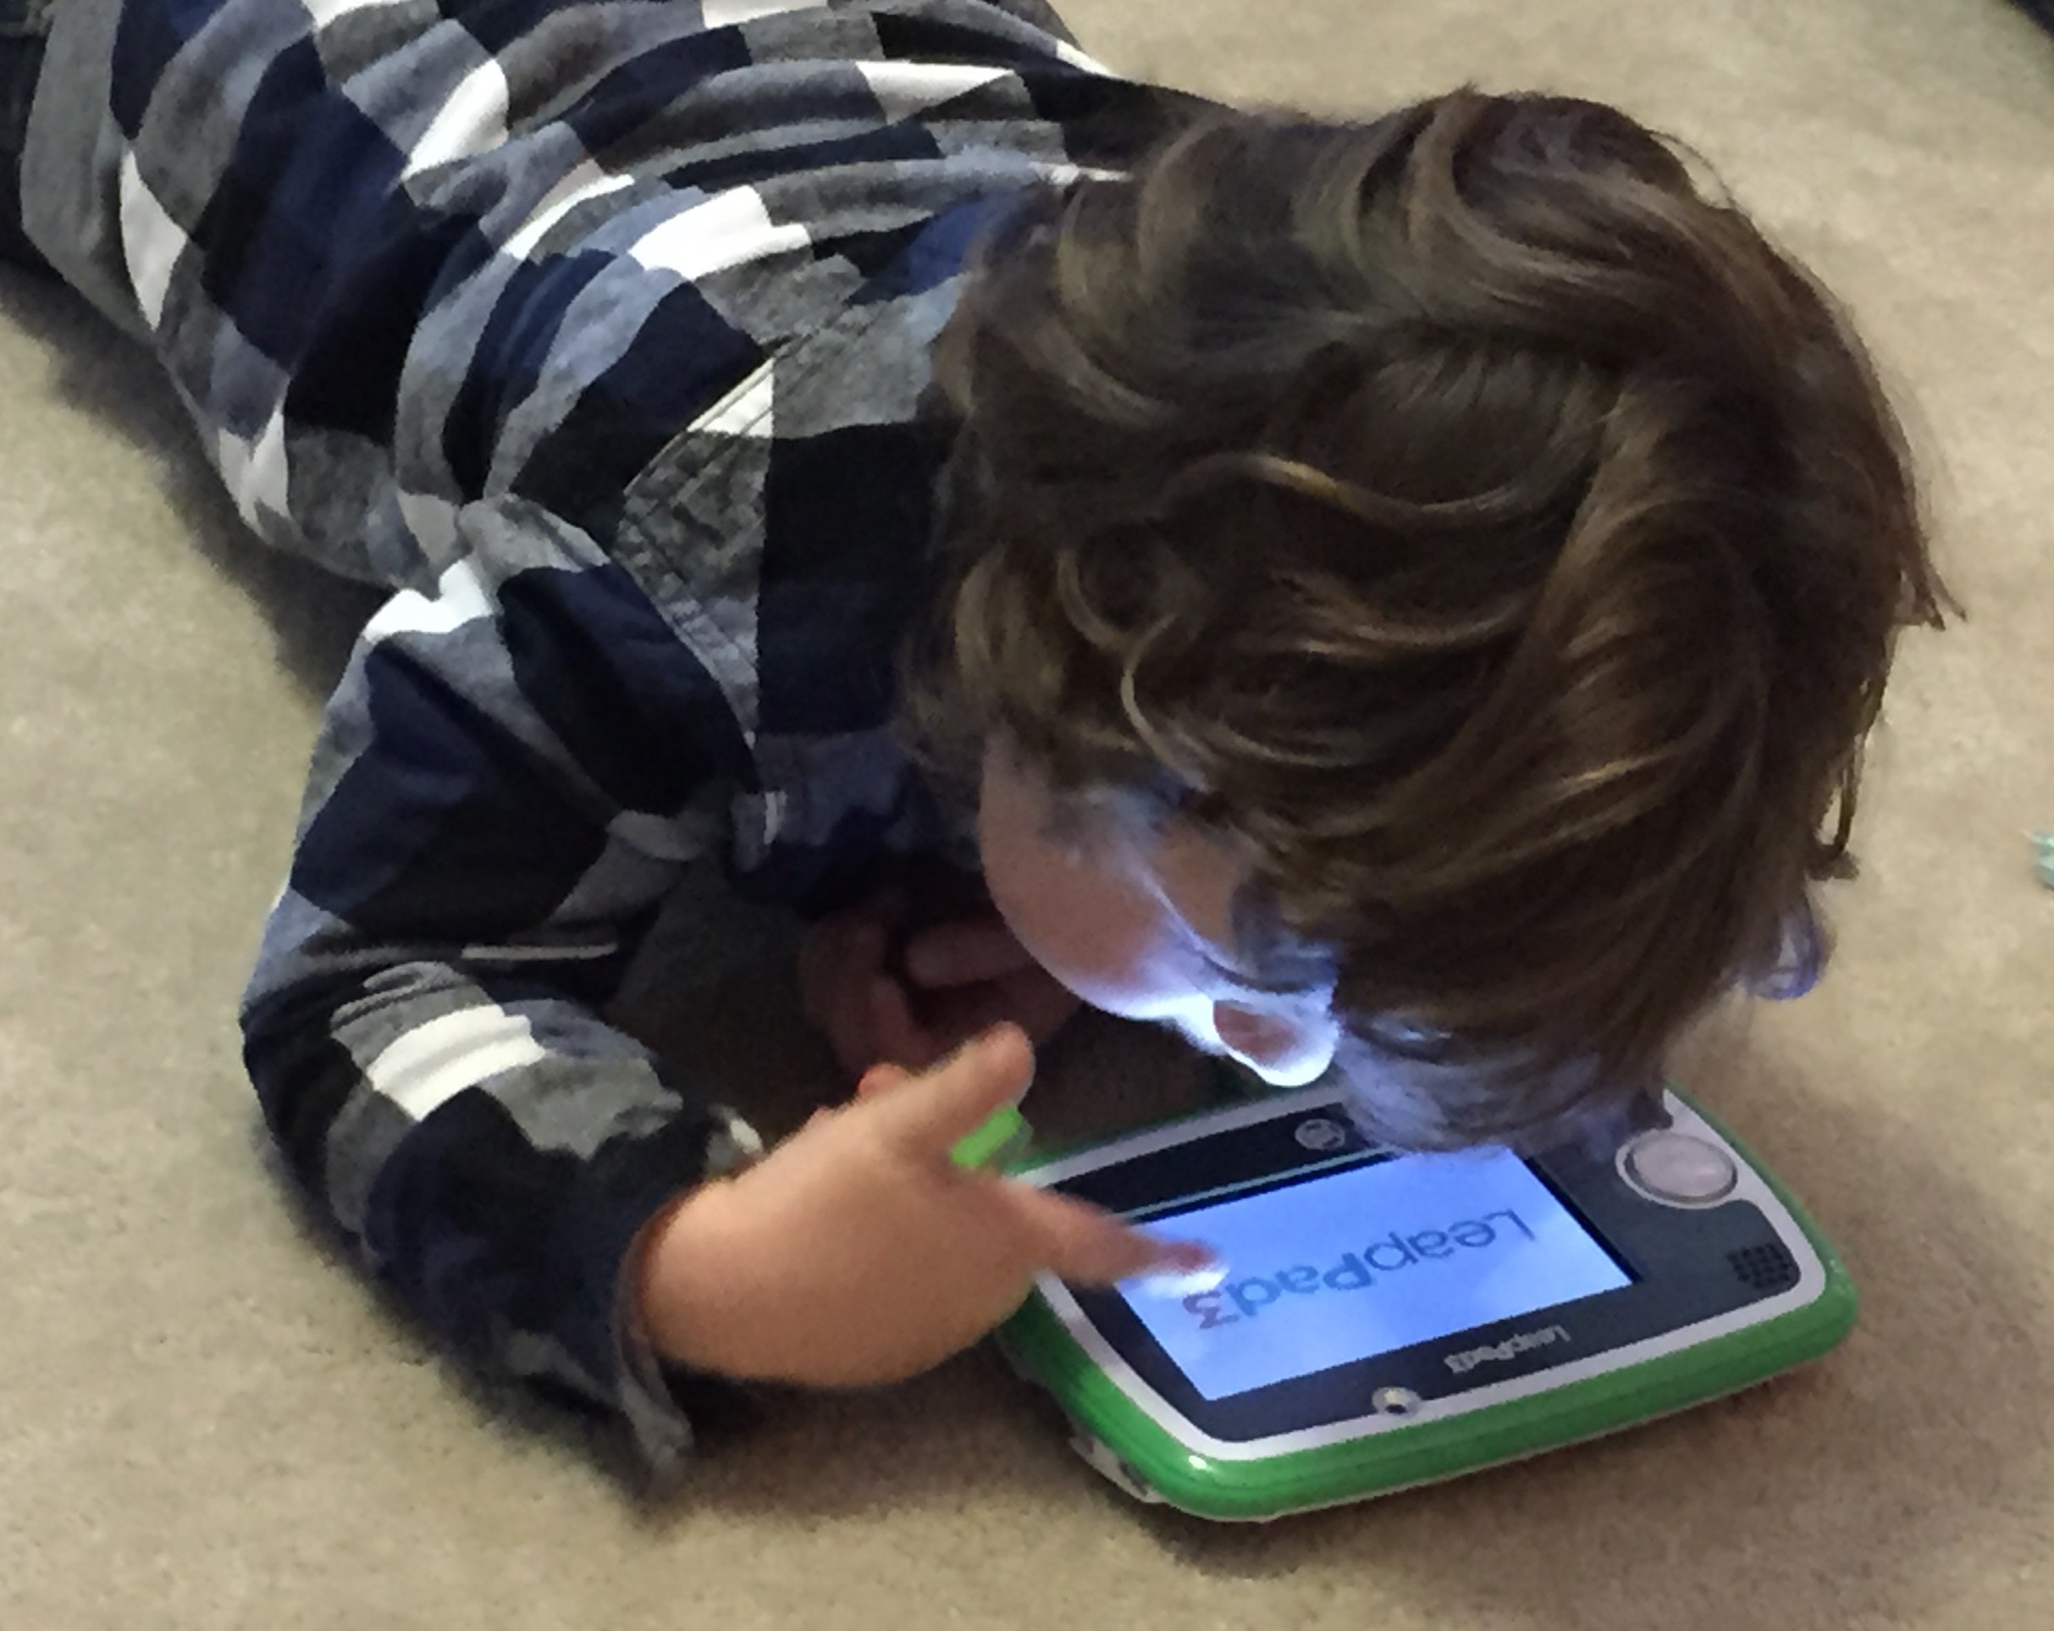

Slide 8
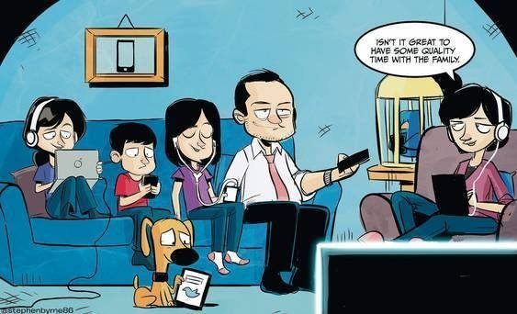

Slide 9
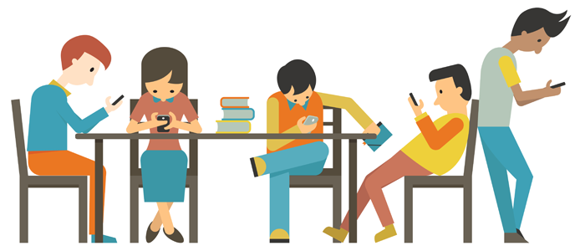

Slide 11
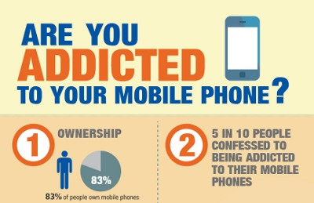

Slide 12
Definition of Addiction
The state of being enslaved to
a habit or practice or to something
that is psychologically or physically habit-forming

Slide 14
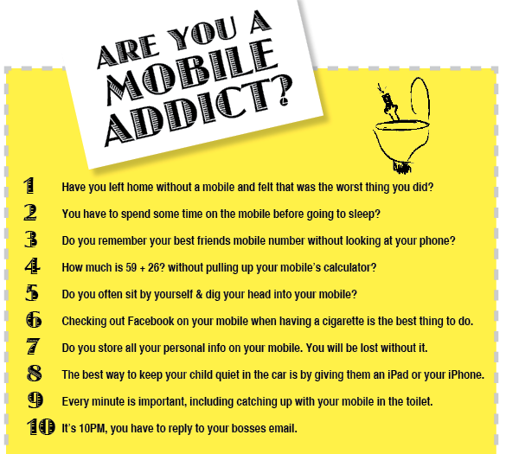

Slide 15
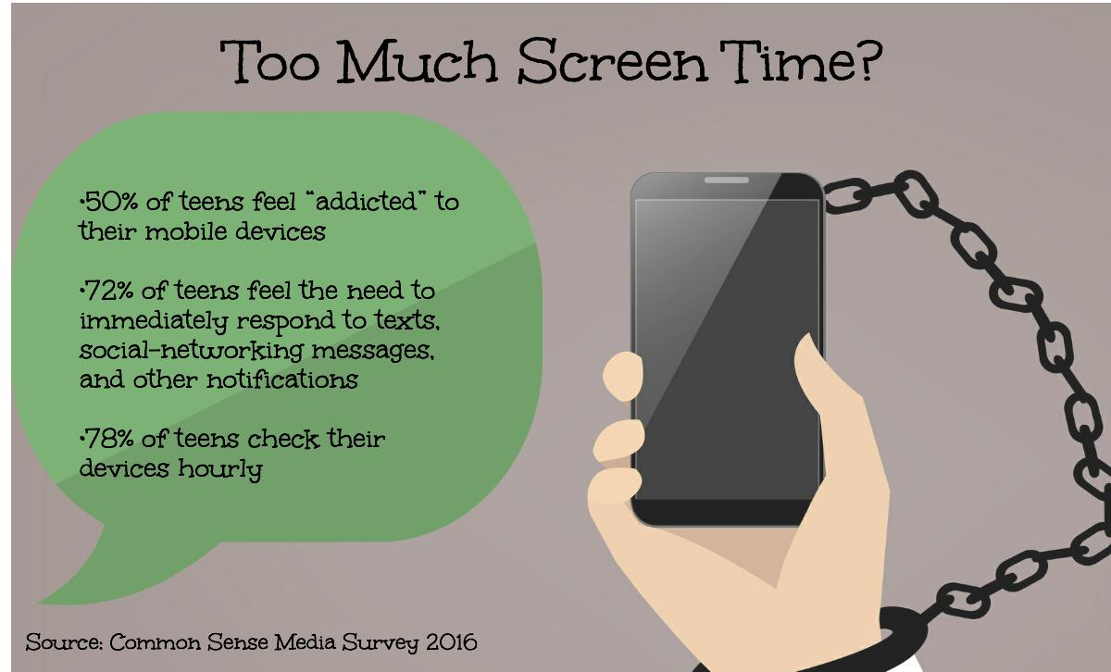

Slide 16
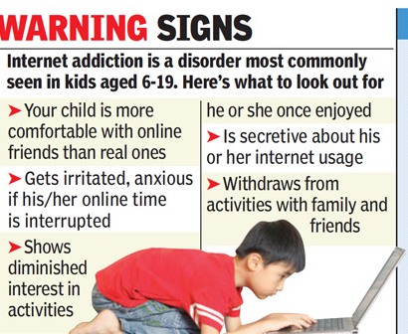

Slide 17
Practical Definition of Addiction
Inability to consistently abstain
Impairment in behavioral control
Craving
Diminished recognition of significant problems with one’s behaviors
Interpersonal relationships
Dysfunctional emotional response

Slide 18
AAP Recommended Screen Time
children younger than 18 months
avoid use of screen media other than video-chatting

Slide 19
AAP Recommended Screen Time
Children 18 months to 24 months
choose high-quality programming
watch it with their children
Help them understand what they're seeing

Slide 20
AAP Recommended Screen Time
Children Between 2 and 5 years
Limit screen use to 1 hour per day of high-quality programs
Parents should co-view media with children to help them understand what they are seeing and apply it to the world around them

Slide 21
AAP Recommended Screen Time
Children older than 6 years
place consistent limits on the time spent using media, and the types of media
make sure media does not take the place of adequate sleep, physical activity and other behaviors essential to health

Slide 22
AAP Recommended Screen Time
For all
Designate media-free times together, such as dinner or driving, as well as media-free locations at home, such as bedrooms
Have ongoing communication about online citizenship and safety, including treating others with respect online and offline

Slide 23
De-Addiction from Mobile
Part-1 : Going on a Cell Phone Diet
Part-2: Considering Alternatives to Using Your Cell Phone
Part-3 : Get Support

Slide 24
De-Addiction from Mobile- Part-1
Going on a Cell Phone Diet
Monitor your cell phone use
Tracking your cell phone use such as adding up how many times per hour you check your phone can increase your awareness about your problem
Try downloading an application that tracks your cell phone use like Checky
Use this information to set a specific goal of how many times per hour or day you allow yourself to check your phone

Slide 25
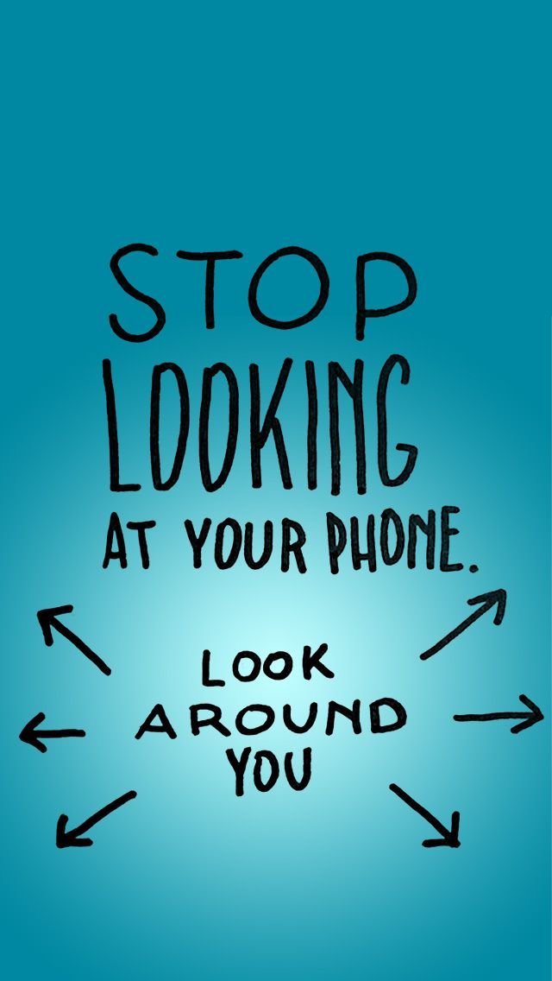

Slide 26
De-Addiction from Mobile- Part-1
Going on a Cell Phone Diet
Create a plan for your phone use
Offer yourself rewards for less time spent on your phone
Start slow. Instead of going cold turkey and completely eliminating your cell phone use (which can be very anxiety provoking), begin by progressively reducing the amount of time you spend checking your phone

Slide 27
De-Addiction from Mobile- Part-1
Going on a Cell Phone Diet
Put your phone away
Turn your phone on silent mode when you are at work, study or anywhere else
Take a cell phone holiday
Go on a trip or camping where there will be no cell service
Change your phone settings. Turn off notification settings
Focus on the here-and-now. Mindfulness, the art of being aware

Slide 28
De-Addiction from Mobile- Part-2
Considering Alternatives to Using Your Cell Phone
Understand your triggers to phone use
Strong desire to be social and connect with others?
Face-to-face contact. Talk when with people
Simply bored?
Can be trigger for addiction
Develop hobbies or reading

Slide 29
De-Addiction from Mobile- Part-2
Considering Alternatives to Using Your Cell Phone
Engage in other mood boosting activities
engage in alternative activities such as exercise/sports or creative activities such as writing or drawing
Keep busy
volunteer at a local organization
New Hobby
Spend more time doing chores

Slide 30
De-Addiction from Mobile- Part-2
Considering Alternatives to Using Your Cell Phone
Redirect your attention by doing something constructive
Focus on your own personal goals and objectives for the day
Make a list of tasks that do not involve your phone
Accomplish social tasks in a different way
Instead of texting, write a letter, or meet up with a friend for coffee or a meal
Invite friend for a board game, cards. etc

Slide 31
De-Addiction from Mobile- Part-3
Getting Support
Notify people about your issue
Simply tell your family and friends that you think you are using your cell phone too much and you are working on cutting down
explain that you would appreciate if they support you in this process
ask them to call or text you only at certain times of the day
Ask for advice
Plan face-to-face meetings

Slide 32
De-Addiction from Mobile- Part-3
Getting Support
Consider treatment
Cell phone addiction is not yet a widely recognized diagnosis
If your cell phone problem is severe and disrupts your daily life and functioning, counseling or mental health treatment may be helpful
Cognitive Behavioral Therapy (CBT)
changing your thoughts in order to change your feelings and behaviors

Slide 34
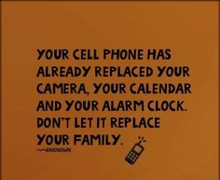

Slide 40
Thank you

