Slide 1
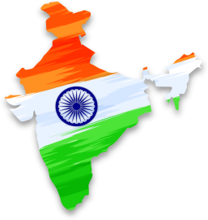
De - addiction OF DRUG & SUBSTANCE ABUSE
Yogesh Zaveri
Rotary Club of
Mumbai Ghatkopar
RID - 3141
yogeshz@hotmail.com
# 9892988114

Slide 2
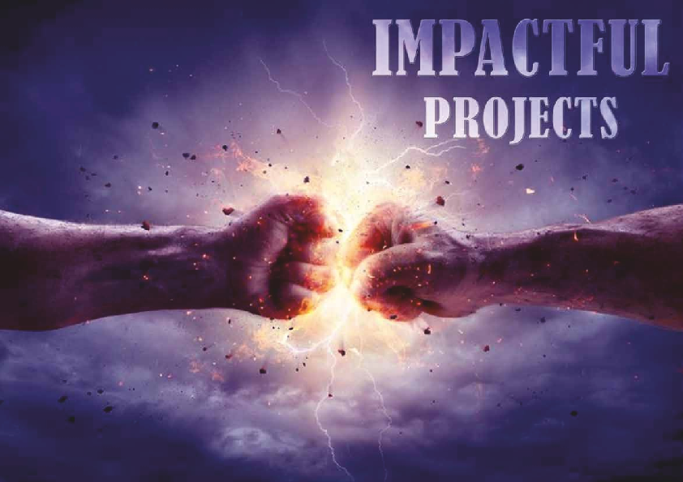
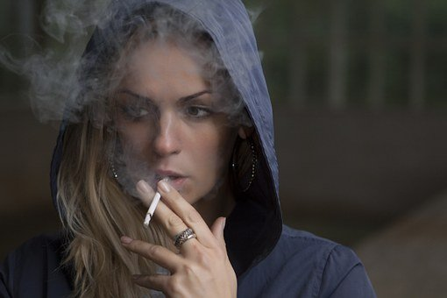

Slide 4
WE WILL FOCUS ON
DE-ADDICTION
& ABUSE OF
DRUGS
THAT ARE NOT LEGAL
& ALSO ON ABUSE OF
PRESCRIPTION MEDICINE
AND
OTHER LEGAL SUBSTANCES

Slide 5
What Is Substance Abuse?
Substance abuse is when you take drugs that are not legal.
It’s also when you use alcohol, prescription medicine, and
other legal substances too much or in the wrong way.
Substance abuse differs from addiction.
Many people with substance abuse problems are able to quit or can change their unhealthy behavior.
Addiction, on the other hand, is a disease.
It means you can’t stop using even when your condition causes you harm.

Slide 6
COMMONLY ABUSED DRUGS FEW COMMONLY USED DRUGS INCLUDING CLUB DRUGS ARE DESCRIBED HEREUNDER BUT OVER AND ABOVE THESE -THERE IS LONG LIST OF DRUGS
Prescription and
Over-The-Counter Medicine (OTC)
Heroin
Cocaine
Marijuana
LSD
Crystal Meth

Slide 7
PRESCRIPTION AND OVER-THE-COUNTER (OTC) MEDICINE
You can abuse medicine if you:
Take medicine prescribed for someone else
Take extra doses or use a drug other than the way it’s supposed to be taken
Take the drug for a non-medical reason

Slide 8
PRESCRIPTION AND OVER-THE-COUNTER (OTC) MEDICINE
These can be just as dangerous and addictive as illegal drugs.
It is considered to be abuse of medicine if you:
1) Take medicine prescribed for someone else
2) Take extra doses or use a drug other than the way it’s supposed to be taken
3) Take the drug for a non-medical reason

Slide 9
PRESCRIPTION AND OVER-THE-COUNTER (OTC) MEDICINE
Types of prescription drugs that are most often abused include:
1) Opioid pain relievers (Common example is of sandwich with Iodex)
2) Medicine used to treat attention deficit hyperactivity disorder
3) Anxiety medicine
4) The most commonly abused OTC drugs are cough and cold medicine which in high doses can make you feel drunk or intoxicated.

Slide 10
HEROIN
This illegal drug is the natural version of manmade prescription Opioid narcotics.
It is made from morphine, a natural substance taken from the seed pod of the various opium poppy plants grown in Southeast and Southwest Asia, Mexico, and Colombia.
Heroin can be a white or brown powder, or a black sticky substance known as black tar heroin.
Other common names for heroin include:
horse, big H, hell dust, and smack.

Slide 11
Heroin gives you a rush of good feelings at first.
But when it wears off, everything slows down.
You’ll move and think more slowly, and you may have chills, nausea, and nervousness.
You may feel a strong need to take more heroin to feel better.

Slide 12
COCAINE
Cocaine is a powerfully addictive stimulant drug made from the leaves of the coca plant native to South America.
Although health care providers can use it for valid medical purposes, such as local anesthesia for some surgeries, recreational cocaine use is illegal.
As a street drug, cocaine looks like a fine, white, crystal powder.
Street dealers often mix it with things like cornstarch, talcum powder, or flour to increase profits.

Slide 13
COCAINE
This drug speeds up your whole body.
When you use cocaine, you may talk, move, or think very fast.
You may feel happy and full of energy.
But your mood may then shift to anger.
You may feel like someone is out to get you.
It can cause you to do things that don’t make sense.
Using cocaine for a long time will lead to strong cravings for the drug.

Slide 14
MARIJUANA
Marijuana—also called Weed, Herb, Pot, Grass, Bud, Ganja, Mary Jane, and a vast number of other slang terms—is a greenish-gray mixture of the dried flowers of Cannabis Sativa.
Some people smoke marijuana in hand-rolled cigarettes called joints; in pipes, water pipes (sometimes called bongs), or in blunts (marijuana rolled in cigar wraps).
Marijuana can also be used to brew tea and, particularly when it is sold or consumed for medicinal purposes, is frequently mixed into foods (edibles) such as brownies, cookies, or candies.
Vaporizers are also increasingly used to consume marijuana.

Slide 15
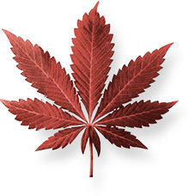
MARIJUANA
Marijuana is one of the most abused drugs in the world.
A handful of states also allow it as a legal recreational pot, some people think that since it is legal in some places, it must be safe, but your body doesn’t know a legal drug from an illegal drug.
It only knows the effect the drug creates once you have taken it.
There are over 400 chemicals in marijuana and hashish.
Marijuana can make you feel silly and laugh for no reason.
Or you may feel sleepy and forget things that just happened.
Driving while high on pot is just as dangerous as drunk driving.
And heavy marijuana use can leave some people “burned out” and not think or care about much.

Slide 16
LYSERGIC ACID DIETHYLAMIDE (LSD)
This drug is available in the form of tablets or gelatin squares and is derived from the ergot fungus that grows on grains like rye.
It has no medicinal use.
LSD creates a bizarre state of hallucinations causing the user to lose touch with reality.
Your Body's reaction: Once ingested, LSD is responsible for constraining consciousness and it stimulates the serotonin receptors in the brain, causing an increase in brain activity, leading to an overactive imagination.
Effects: This can lead to severely impaired judgment and the person loses the ability to comprehend physical sensations and environment correctly. These conditions can cause terrors and panic attacks and send the user into a state of shock.

Slide 17
CRYSTAL METH
This drug is highly addictive and is a powerful central nervous stimulant.
Crystal meth is the illegally manufactured, crystalline form of methamphetamine.
Your Body's reaction: The drug travels through the blood stream to the brain and stimulates the release of dopamine, that is three times more than that produced by cocaine and six times more than what the body can produce naturally.
Effects: The high can cause hyperactivity, making the user push their body beyond its limit and resulting is a severe crash once the effects of the drug have worn off.
Other short-term side effects include extreme weight loss, disturbed sleep patterns, nausea, increased aggressiveness and irritability. In some cases, use can cause convulsions that lead to death.
Long-term effects include damaged blood vessels in the brain, leading to strokes, cardiovascular collapse or death, and liver, kidney and lung damage.
Addicts also suffer from brain damage, memory loss and those who recover usually suffer from memory gaps and extreme mood swings.

Slide 18
SUMMERY OF EFFECTS OF DRUGS
Some drugs make you feel invincible, some make you forget your worries and troubles and others 'pretend' to enhance your creativity.
The only thing they have in common is that their high is short-lived.
Another thing they have in common is that they all have harmful long-term effects.
You can successfully trick your brain into feeling ecstatic and blissful for a short while, but if you are exposed to an overdose, it could lead to serious complications and even death, in many rather most cases.

Slide 19
DIAGNOSIS
Diagnosing drug addiction (substance use disorder) requires a thorough evaluation and often includes an assessment by a psychiatrist, a psychologist, or a licensed alcohol and drug counselor.
Blood, urine or other lab tests are used to assess drug use, but they're not a diagnostic test for addiction.
However, these tests may be used for monitoring treatment and recovery.
For diagnosis of a substance use disorder, most mental health professionals use criteria in the Diagnostic and Statistical Manual of Mental Disorders (DSM-5), published by the American Psychiatric Association.

Slide 20
TREATMENT
Although there's no cure for drug addiction, treatment options explained below can help you overcome an addiction and stay drug-free.
Treatment depends on the drug used and any related medical or mental health disorders you may have.
Long-term follow-up is important to prevent relapse.
Chemical dependence treatment programs
Treatment programs usually offer:
Individual, group or family therapy sessions.
A focus on understanding the nature of addiction, becoming drug-free and preventing relapse.
Levels of care and settings that vary depending on your needs, such as outpatient, residential and inpatient programs.

Slide 21
DETOXIFICATION
The goal of detoxification, also called "detox" or withdrawal therapy, is to enable you to stop taking the addicting drug as quickly and safely as possible.
For some people, it may be safe to undergo withdrawal therapy on an outpatient basis.
Others may need admission to a hospital or a residential treatment center.
Withdrawal from different categories of drugs - such as Depressants, Stimulants or Opioids - produces different side effects and requires different approaches.
Detox may involve gradually reducing the dose of the drug or temporarily substituting other substances, such as Methadone, Buprenorphine, or a combination of Buprenorphine and Naloxone.

Slide 22
PREVENTION PROGRAMMES
As with any disease, prevention is the best medicine.
Programmes for prevention of Drug abuse typically consists of methods or activities that seek to reduce or deter specific or predictable problems, protect the current state of well-being, or promote desired outcomes or behaviors.
Substance Abuse Prevention, also known as drug abuse prevention, is a process that attempts to prevent the onset of substance use or limit the development of problems associated with using psychoactive substances.
Prevention efforts may focus on the individual or their surroundings.
Drug demand reduction programmes should emphasize on not stigmatizing addicts, but rather trying to educate people, particularly school and college students.

Slide 23
PREVENTION PROGRAMMES
We have designed and developed following programmes to offer to the clubs wanting to be active in prevention activities for Addiction of Drug / Substance Abuse

Slide 24
WORKSHOPS AND LECTURES IN COMMUNITY
Drug abuse has serious consequences in our homes, schools, and communities.
An active club can invite experts from the field and organize awareness lectures in schools and colleges for the benefit of students community.
Past recovered addict can be good advocate for prevention.
Students may be motivated for street plays on prevention.
A poster competition can be organized.
Videos can be played in schools / class on the addiction prevention subject.
Debates and Essay competitions can be organized with the incentives of a trophy and certificates of participations.

Slide 25
MINI UNPLUGGED WORKSHOPS
What is UNPLUGGED?
Unplugged is a drug (including alcohol, tobacco, etc.) prevention programme initiated by the EU-DAP (European Union Drug Abuse Prevention) that attempts to address this need.
Unplugged is researched and developed by collaboration of 7 European Countries’ Universities under guidance of EU-DAP

Slide 26
WHAT IS UNPLUGGED PROGRAMME?
Unplugged programme targets school children between 12 to 14 years of age.
It is based on a social influences approach, and aims to promote positive social and health behavior generally, and substance abuse prevention in particular.
Where already adapted, it has shown outcomes such as delay in onset of drug use and reduction of use of alcohol, tobacco, etc.
It was introduced by RC Mumbai Ghatkopar as ‘Training of the Trainers’
Trained teachers in turn will conduct the programme in their schools for 7th to 9th standard students, ie 12 to 14 years children.

Slide 27
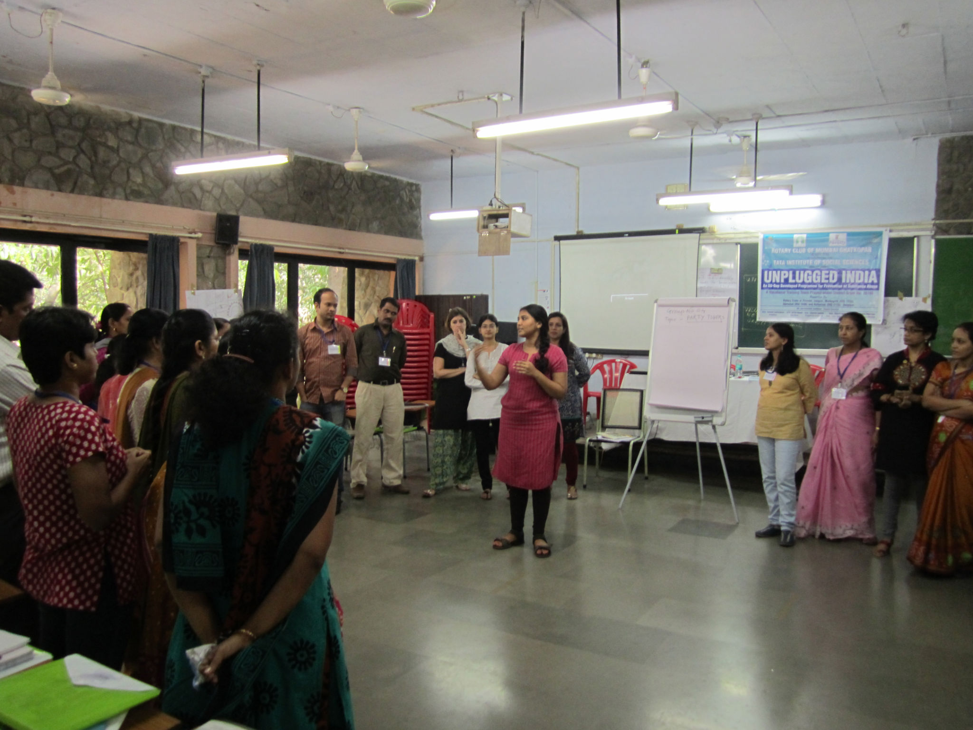

Slide 28
MINI UNPLUGGED
With the inputs from Dr. Anuradha - a trained Unplugged professional and Professor and Head, Department of Psychology, Associate Dean, Humanities, SNDT WU, Trustee and Consultant, Institute for Psychological Health, Thane a Round Table for discussions was conducted on the limitation of Indian School’s culture.
As an outcome of these discussions a condensed version of the entire Unplugged programme has been now developed which can be implemented for one day and ensuring all the elements of the Basic Unplugged are being included.
This has been piloted and is found to be effective for our schools in India.
At present the programme is available in English and Marathi languages and can be implemented by trained counselors.

Slide 29
SHACKLEFREE WORKSHOPS
‘Shacklefree’ is a completely new and indigenously developed program.
It is developed by SNDT Women University under Rotary Club of Mumbai Ghatkopar sponsored, Global Grant Programme funded by The Rotary Foundation.
It will emerge as the new deliverable of RAGAP project.
Broader coverage, includes substance AND non substance addictions.
Non substance addictions are an emerging issue of huge concern for society, the world over, i.e. The screen time in children, Gaming and Gambling which is in fact worse than substance addictions.

Slide 30
SHACKLEFREE MANUALS
Final set of manuals which will consists of Facilitator Manual for Shacklefree, Training the Trainer Handbook for Shacklefree and Most Unique: Shacklefree Resource Package for Addiction Prevention.
All these materials will be put on Rotary RAGAP website and also printed.
It will be made available to all centers where Psychology training in SNDT will take place.
Board of Studies have included these in new syllabi.
Thus we will have many trained counsellors available for conducting this programme in schools.

Slide 31
TRAINING PROGRAMMES FOR FAMILY PHYSICIANS
In the year 2014 – 15 on Rotary District 3140, (Now RID 3141) we launched yet another programme for Training of Family Physicians as ‘Certificate Course in Addiction Medicine’.
It has been started in collaboration with Muktaa Charitable Foundation of Pune, under guidance of Dt. Prakash Mahajan and Dr. Madhu Oswal Thakkar.
More than 25 successful workshops have been held so far training 1200 plus doctors.
Earlier we use to conduct seven sessions of 3 hrs in seven weeks, but now it has been condensed to two full days normally week ends.

Slide 32
TOPICS OF TRAINING PROGRAMMES FOR FAMILY PHYSICIANS
1 WHY ARE WE LEARNING ABOUT ADDCITIONS?
2 UNDERSTADING ADDICTION
3 UNDERSTADING BIO SOCIO PYCHOLOGICAL CAUSES OF ADDICTION
4 BREIF INTERVENTION AND MOTIVATION ENHANCEMENT TECH
5 NICOTINE ADDICTION
6 ORAL CANCER SCREENING
7 ALCOHOL ADDCITION
8 OTHER HARD DRUGS
9 CANNABIS, AND OPIUM
10 UNDERSTANDING THE SUPPLY CHAIN
11 ROLE PLAYS
12 WRITTEN QUIZ
13 SHARING BY RECOVERING ADDICTS
14 CASE DISCUSSIONS
15 ORAL QUIZ
16 AVAILABLE MEDICINES - PRESENTATION BY PHARMA COMPANY
17 CLOSING CEREMONY

Slide 36
WHAT CAN WE DO?
Action for Rotary Clubs
Clubs to appoint a Addiction Prevention Committee (APC)
Club APC will be guided & supported by district APC
Resources for implementation of various programs/ projects will be shared with clubs by District/ National APC/ Others

Slide 37
THANK
YOU

