Slide 1
Alcohol Addiction
PDG Dr Shailesh Palekar

Slide 2
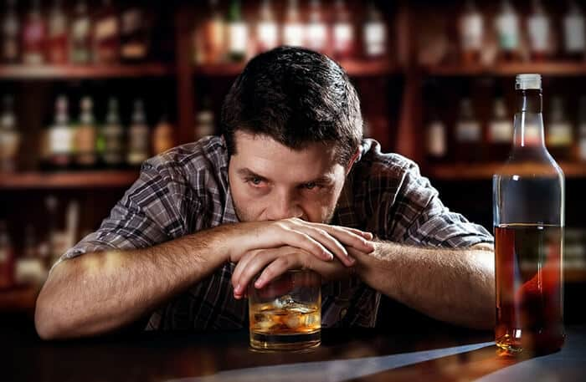
Why is this topic Discussed
It destroys individuals
It ruins Families
Causes Social Problems

Slide 3
Is Alcohol Beneficial ?
Low level intake of alcohol has beneficial effects – upto 2 standard drinks
Increased Good Cholesterol
less strokes and Heart Disease
less episodes of vascular Dementia
Less incidence of Alzeimer’s Disease

Slide 4
Problem with Alcohol
20 % of Men and 10 % of women have repetitive alcohol problems
Intake of more than 3 standard drinks per day enhances cancer and vascular disorders
Problem increasing in Younger Generation
Repeated use of alcohol causes Acquired Tolerance
Excess alcohol hurts virtually all organs
Alcohol Abuse
Alcohol Dependance

Slide 5
Alcohol and Organ Effects
Nervous System – Memory Disturbances / Sleep Disorders / Peripheral Neuropathy/ Cerebellar Degeneration / Wernikes Korsakoffs Pyschosis
GI System – Severe Acidity / Vomiting / Bleeding
Pancreas – Acute Pancreatitis – can be Life Threatening
Liver – Cirrhosis of Liver in 15 % of patients
Cancers – Breast Cancers / Oral and Oesophageal Cancers
Haemopoetic – Low Vit B12 and Folic Acid / Low Platelets
Cardiovascular – Hypertension / IHD / Cardiomyopathy / Arrhythmias
Sexual Dysfunction
Accidents

Slide 6
What is Alcohol Abuse
An uncontrollable urge to drink
Lack of control over how much you drink
Negative thoughts when you're not drinking alcohol
Drinking in risky situations
Drinking that interferes with fulfilling obligations
Continuing to drink even though it causes problems or makes them worsen
Stopping or doing less of important activities because of alcohol
50% of Alcohol Abuse patients continue to have problems related to alcohol 5 years later but only 10 % develop Alcohol Dependance

Slide 7
When do You suspect Alcohol Use Disorder
You can't relax or fall asleep without drinking.
You need a drink in the morning to get going.
To be social, you have to drink.
Alcohol serves as your escape from feelings.
After drinking, you drive.
You mix alcohol and medications.
You drink when you're pregnant or caring for small children.
When loved ones ask how much you drink, you don't tell the truth.

Slide 8
Continue - AUD
You hurt people or become angry when you drink.
It's tough for you to remember what you did when you were drinking.
Your responsibilities suffer because of your drinking.
Drinking has caused you legal problems.
You tried to stop drinking but failed.
You can't stop thinking about drinking.
To feel the effects of alcohol, you have to drink more and more.
You have withdrawal symptoms after you stop drinking for too long, like shakiness, nausea, trouble sleeping, or seizures.

Slide 9
What is Alcohol Addiction / Dependance
Alcoholism is the most serious form of problem drinking, and describes a strong, often uncontrollable, desire to drink. Sufferers of alcoholism will often place drinking above all other obligations, including work and family, and may build up a physical tolerance or experience withdrawal symptoms if they stop.

Slide 10
How do you suspect Alcohol Dependance
A lack of interest in previously normal activities
Appearing intoxicated more regularly
Needing to drink more in order to achieve the same effects
Appearing tired, unwell or irritable
An inability to say no to alcohol
Anxiety, depression or other mental health problems
Becoming secretive or dishonest

Slide 11
How do we approach such cases
In many cases, the first step of treating alcoholism is acknowledging there is a problem.
As with many health problems the second step is to seek help from a healthcare professional, like your local GP who can refer you to a specialist

Slide 12
Treatment Modalities
There are different treatments available for people diagnosed with alcoholism but a key stage of treatment is detoxification.
Detox involves stopping drinking completely so that the body can adjust to being without alcohol. During this time, a person may experience alcohol withdrawal symptoms.
Psychological and psychosocial treatments can involve counselling to help you understand and change your attitude towards drinking.

Slide 13
Rx - Continued
Cognitive Behavioural Therapy (CBT) can also be offered to help change negative thought patterns which lead to drinking.
Mutual help such as Alcohol Anonymous help partly because of the new network of support a person gains and also because people adjust their thinking and their attitudes to themselves and others.
Pharmacological treatments (i.e. medications) can also have a role in preventing relapse for some people who are trying to abstain, or trying to reduce their drinking.

Slide 14
Benefits of Rx
50-60 % Alcoholics maintain abstinence for years and even permanently
Even without Rx – 20 % chance of spontaneous remission with long term abstinence
If frequenct relapses – life span shortened by at least 10 years

Slide 15
Major Causes of Death
Heart Disease
Cancer
Accidents
Suicide

Slide 16
Role of Rotary
Identify Target Audience for creating AWARENESS of pitfalls of Alcoholism
Target Audience is all age groups – School Children
College Students
Youth in Corporates
Senior Citizens

Slide 17
AWARENESS PROGRAMS
Presentations
Short Documentary to be prepared – run in theatres / Schools / Colleges
Brand Ambassador to be identified
Essay Competitions on Addictions and problems related to it
Success Stories of De - Addicted People
Camps in Happy Villages / Happy Schools
Rotaract to promote our ppt in their colleges

Slide 18
Identification – Rx and Rehabilitation
Hold Medical Check Up Camps for identifying Addicts
Refer them to Empanelled Doctors by Rotary
Connect them with Alcohol Anonymous Groups

Slide 19
Lets Give up on Alcohol Abuse

